Slide 1
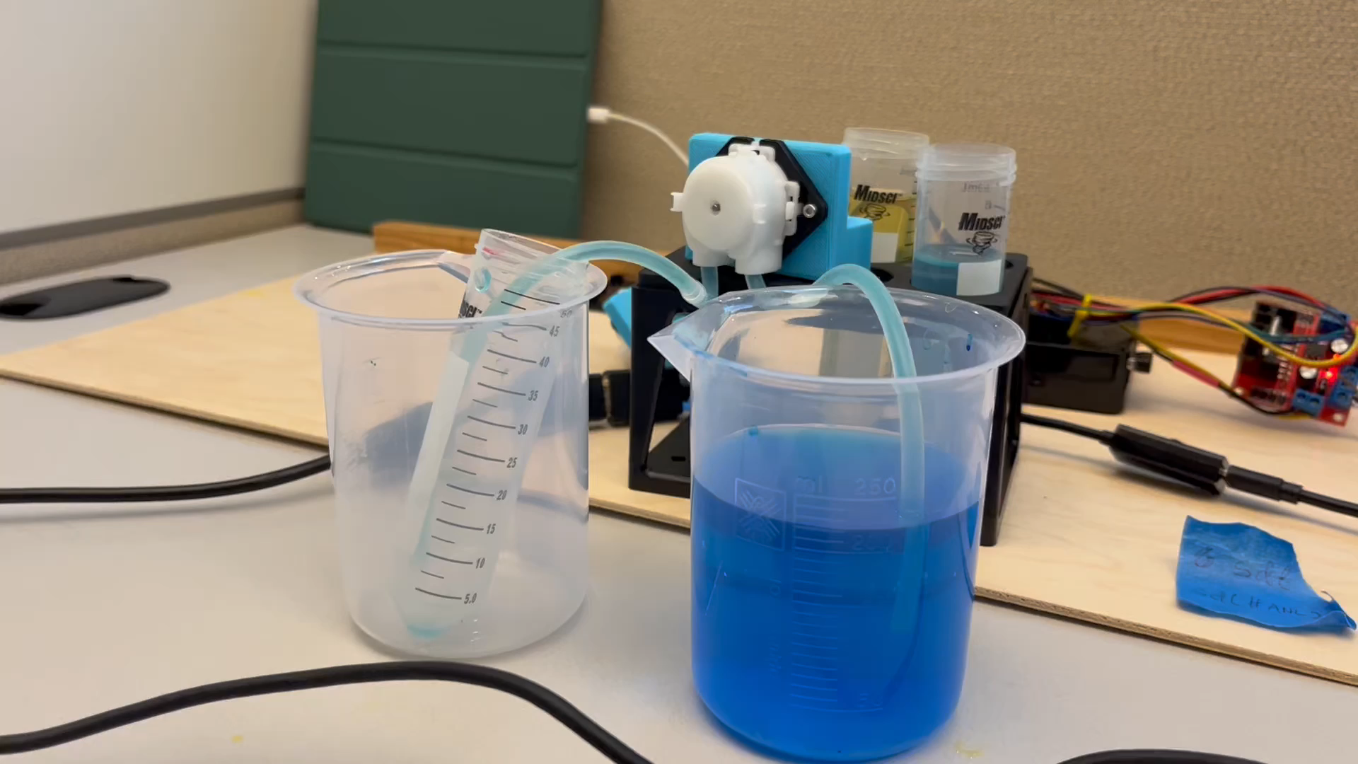
Aileen Cleary – 06/29/2023
Overall Goal: 1) Create an autonomous liquid refill system for Color Picker and 2) Write a program that dynamically visualizes (Color Picker’s) YAML files and experiment logs.
Weekly Goal: Continue coding Barty’s liquid refill system and designing his physical build.
Progress:
Worked with Raf on developing concept for physical build.
Created and ran a test endpoint on Barty’s server to control the peristaltic pumps.
Attempted to run color picker to see how liquid volume is calculated and stored.
Exactly 50mL!
Challenges:
Long weekend and meetings meant less time to work.
Logan failed to boot up properly and technical issues with Ripchip → no color picker.
Next Steps:
Create and buy list of parts for the physical build (5V power supply, push button).
3D-model frame to hold Barty up.
Determine component placement and mark/drill holes.
Try and run color picker again.
Continue working on GitHub.

